Slide 1



CAAFI 2014
General Meeting
& Expo
International Initiatives
Moderated by: Lourdes Maurice, FAA
Special Guest: Jane Hupe,
Chief of ICAO Environment Branch
Produced by

Slide 2









Coordinating with Global Efforts
CAAFI
ABRABA/SABB
SWAFEA/Alfabird
Australia / AISAF
ICAO
Aireg
Bioqueroseno.es
Sky NRG
IFP Energy Nouvelle
Formal and informal coordination
  Coordination with R&D organizations
  International Airshows
  Bilateral Cooperation Agreements
ICAO as forum for exchange
Notes:
Effort is truly a global one
Many different initiatives emerging –
public-private partnerships, public R&D initiatives, Supply chain efforts
FAA & CAAFI have been working to coordinate formally and informally
Inlcuding:
Govt. to govt. agreements – non-binding cooperative – umbrella for private sector activity – mutual strengthening at policy making level
We also support and participate with[UN organization] ICAO in it’s role for exchange of best practices among member States.

Slide 3
CAAFI 2014
General Meeting
& Expo
International Initiatives
Jane Hupe,
Chief of ICAO Environment Branch
Produced by

Slide 4
SUSTAINABLE ALTERNATIVE FUELS
IN THE CONTEXT OF
INTERNATIONAL AVIATION
Jane Hupe
Chief, ICAO Environment Branch

Slide 5
About ICAO
International Civil Aviation Organization
Specialized Agency of the United Nations
Created in 1944 by the Convention on International Civil Aviation (Chicago Convention)
Membership: 191 Member States
Mission: to ensure the safe and orderly development of international civil aviation
Mandate: to establish and update the Standards and Recommended Practices (SARPs) of the Annexes to the Convention

Slide 6
About the ICAO Assembly
The ICAO Assembly is the Organization’s sovereign body.
It meets at least once every three years and is convened by ICAO’s governing body, the Council.
ICAO's 191 Member States and a large number of international organizations are invited to the Assembly, which establishes the worldwide policy of the Organization for the upcoming triennium.

Slide 7
ICAO Environmental Goals
Quantify
Mitigate
Implement
Limit or reduce the number of people affected by significant aircraft noise
Limit or reduce the impact of aviation GHG emissions on global climate
Limit or reduce the impact of aviation emissions on local air quality
Minimize the adverse effect of global civil aviation on the environment
Notes:
To ensure the quality of environment, all ICAO Member states agreed to establish three aviation environmental goals:
a) limit or reduce the number of people affected by significant aircraft noise;
b) limit or reduce the impact of aviation emissions on local air quality; and
c) limit or reduce the impact of aviation greenhouse gas emissions on the global climate
These goals acknowledge that we need to maintain compatibility between safe and orderly growth while ensuring the quality of environment.

Slide 8


ICAO’s Role with Alternative Fuels
                ICAO is a FACILITATOR
                Outreach
                Information exchange
                International collaboration
                Broader view
                Globally
ICAO
Notes:
Slide 5 – So, what does ICAO have to do with alternative fuels? Well, we don’t produce fuel – you’ll never see an aircraft being fuelled from a Petricao truck. We don’t certify it, either. But, as the United Nations specialized agency for international civil aviation, we bring States and stakeholders together. We are a facilitator.
We provide the forum for outreach, information exchange, and international collaboration.

Slide 9
ICAO’s Work on Alternative Fuels
Resolution A36-22 Promote improved understanding
Rio Conference ICAO as a facilitator
GFAAF Created
Rio+20: the ICAO’s “Flightpath” Initiative
Resolution A38-18
2007
2009
2009
2011
2012
2013
2013
Workshop
Cooperation and Harmonization
Workshop
States, financial institutions and stakeholders
ICAO SUSTAF Group
Input to Assembly
Notes:
Our work on alternative fuels is not new.

Slide 10
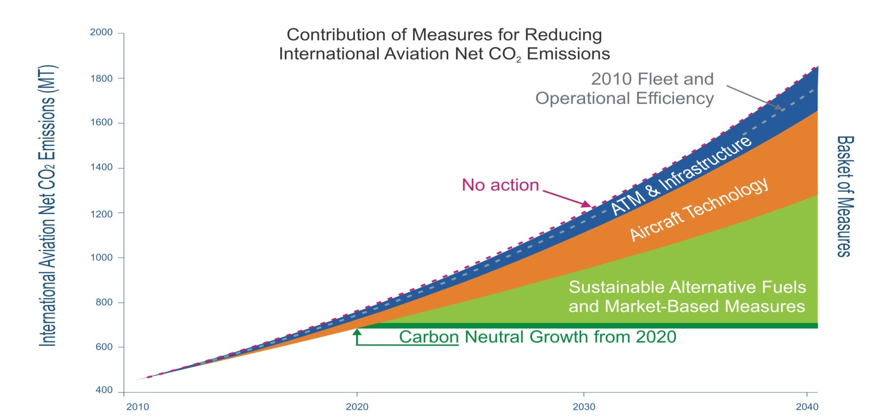
Climate change
Aspirational goals and basket of measures
Notes:
This chart represents the most recent analysis of the organization of possible contribution of the various elements in the basket of measures. We had hoped to be able to include a wedge for alternative fuels going out to 2040 or 2050 as we have done with the other more “mature” elements – air traffic management and infrastructure use, and aircraft technology, but as everyone in this room appreciates, it is very difficult to predict the potential contribution to global international aviation emissions by alternative fuels.

Slide 11
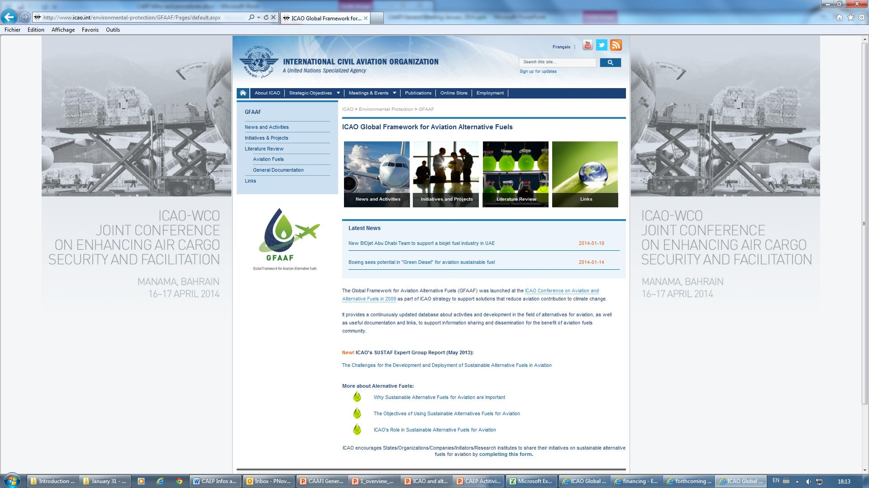
Global Framework for
Aviation Alternative Fuels (GFAAF)
Notes:
In support of improved understanding of alternative fuels and to facilitate information exchange, we have developed and recently enhanced the Global Framework for Aviation Alternative Fuels, with information on initiatives that are planned and underway worldwide. This constantly growing database includes nearly 400 announcements and initiatives today.

Slide 12
Resolution A38-18: ICAO’s Mandate from its 191 States on Alt. Fuels
Member States, industry, financial institutions and other international organizations to actively participate in exchange of information and best practices and in further work under ICAO on sustainable alternative fuels for aviation
Continue to maintain the ICAO Global Framework for Aviation Alternative Fuels (GFAAF)
Collect information on progress of alternative fuels in aviation, to give a global view of the future use of alternative jet fuels and to account for changes in life cycle GHG emissions in order to assess progress toward achieving global aspirational goals
Work with financial institutions to facilitate access to financing infrastructure development projects dedicated to sustainable aviation alternative fuels and incentives to overcome initial market hurdles
Notes:
The information on the previous slide was presented to the Assembly last September. Their new resolution included a strong mandate for ICAO in the area of alternative fuels. Specifically on:
Bringing together States, industry, financial institutions, and other international organizations to actively participate in an exchange of information and best practices, under ICAO, on sustainable alternative fuels for aviation.
Continued update of the Global Framework
Collecting information on progress of alternative fuels to give a global view
Working with financial institutions to facilitate access to financing for sustainable alternative fuels projects as well as incentives to overcome initial market hurdles.

Slide 13
Resolution A38-18:
Additional related requests
Voluntary preparation and update by States of action plans outlining policy actions on CO₂ emissions reduction and fuel efficiency improvement activities
Guidance and assistance for preparation of action plans
Estimation, monitoring and verification of global greenhouse gas (GHG) emissions produced by international aviation
Update of environmental trends assessment
Many elements developed with the support of CAEP

Slide 14
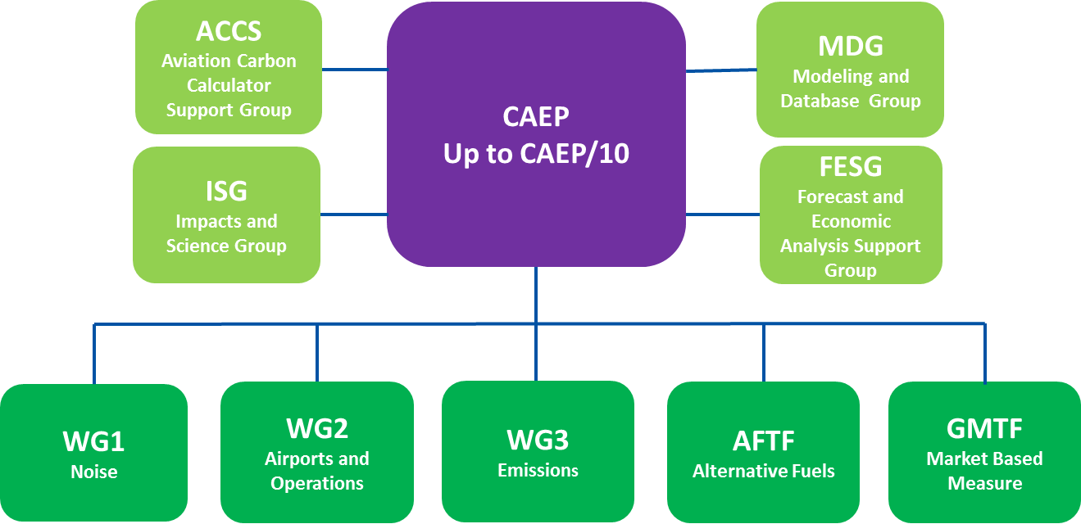
Committee for Aviation Environmental Protection (CAEP)
Established by the ICAO Council in 1983
23 members States – 16 Observer States and Organizations
400 internationally-renowned experts involved
Notes:
Alternative Fuels Task Force will contribute in 2 important areas:
Projections for future sustainable alternative fuels production
Fuels life cycle emissions

Slide 15

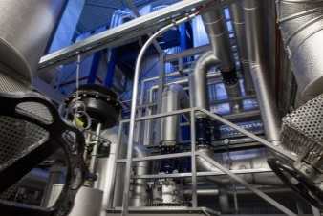
CAEP Alternative Fuels Task Force
Goal: assessing the potential range of emissions reductions from the use of alternative Fuels to 2050
2 directions of work:
  Life Cycle Assessment of alternative jet fuels
  Projection of the future production of
  alternative jet fuels
CO₂
LCA
Notes:
The purpose of the new Alternative Task Force is to assess the range of potential emissions reductions from the use of alternative fuels to 2050. It will have to address two critical issues to achieve its work:
One is the way life cycle emissions reduction from alternative fuels should be estimated and accounted for;
The other is the projection of the future production of alternative fuels.
This work will also so allow to provide a basis for providing assistance and guidance to States on the assessment of the potential benefits of using alternative fuels in the elaboration of their action plan, in order to make it easier to aggregate States’ information for building a global view of the contribution of alternative fuels to the achievement of ICAO’s aspirational goals.
It will also provide inputs to maintain and enhance methodologies to estimate, monitor and verify GHG emission from international aviation as requested by the Resolution.
The results of the Alternative Fuel Task Force will finally provide direct inputs for the the environmental trends assessment performed by the modeling and Database Group of CAEP.
The task force chairmen are Cesar Velarde from Spain and Jorge Silveira from Brazil.

Slide 16
Conclusion
International cooperation is the core of ICAO’s activities
  Information/best practices sharing and dissemination
  Global view to support decision making built on States’ contributions
Cooperation among aviation stakeholders and with the energy sector is key, in particular to addressing sustainability and securing access of aviation to sustainable fuels
Notes:
What are we doing and how can we contribute in this area at ICAO?
First, ICAO is a facilitator to support States and industry in their effort to deploy alternative fuels. Its role is to provide fora for education, outreach and exchanges between States and stakeholders. It is to support information exchanges and dissemination of information. And it can be to facilitate the development of standardized definitions, methodologies and processes.
ICAO is also a key actor to provide a global view and support informed decision making. This is achieved through data collection and in particular through the States Action Plans which are an important tool for States to provide the information on what they are doing. This is also done through projection and scenario building to assess the future environmental trends of aviation.

Slide 17
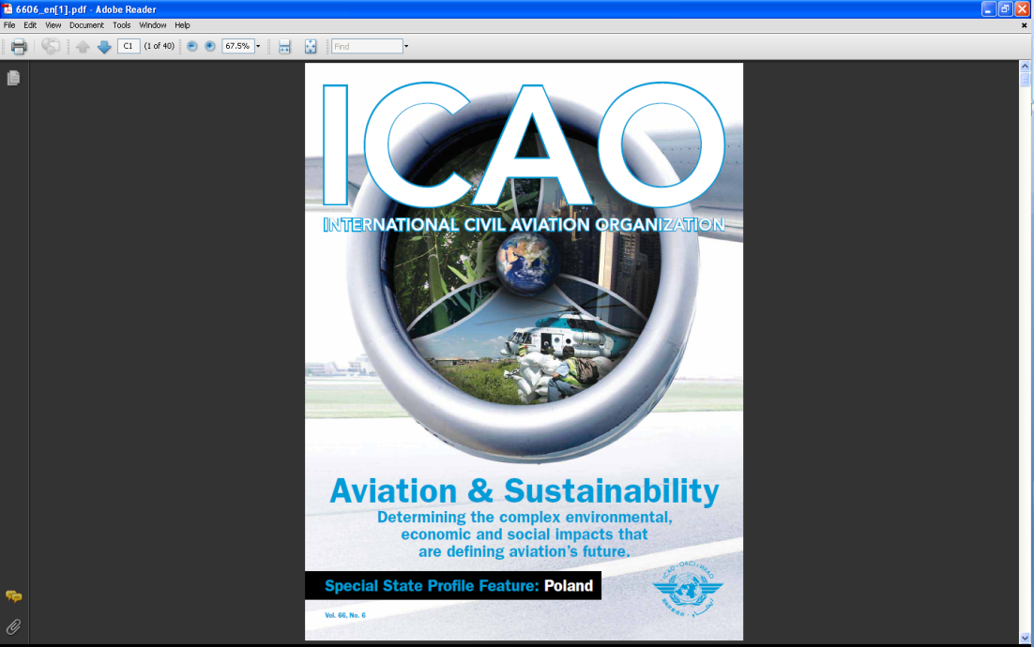
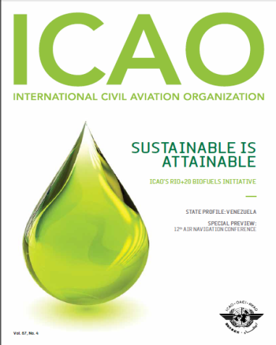
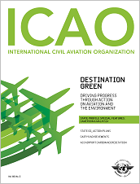
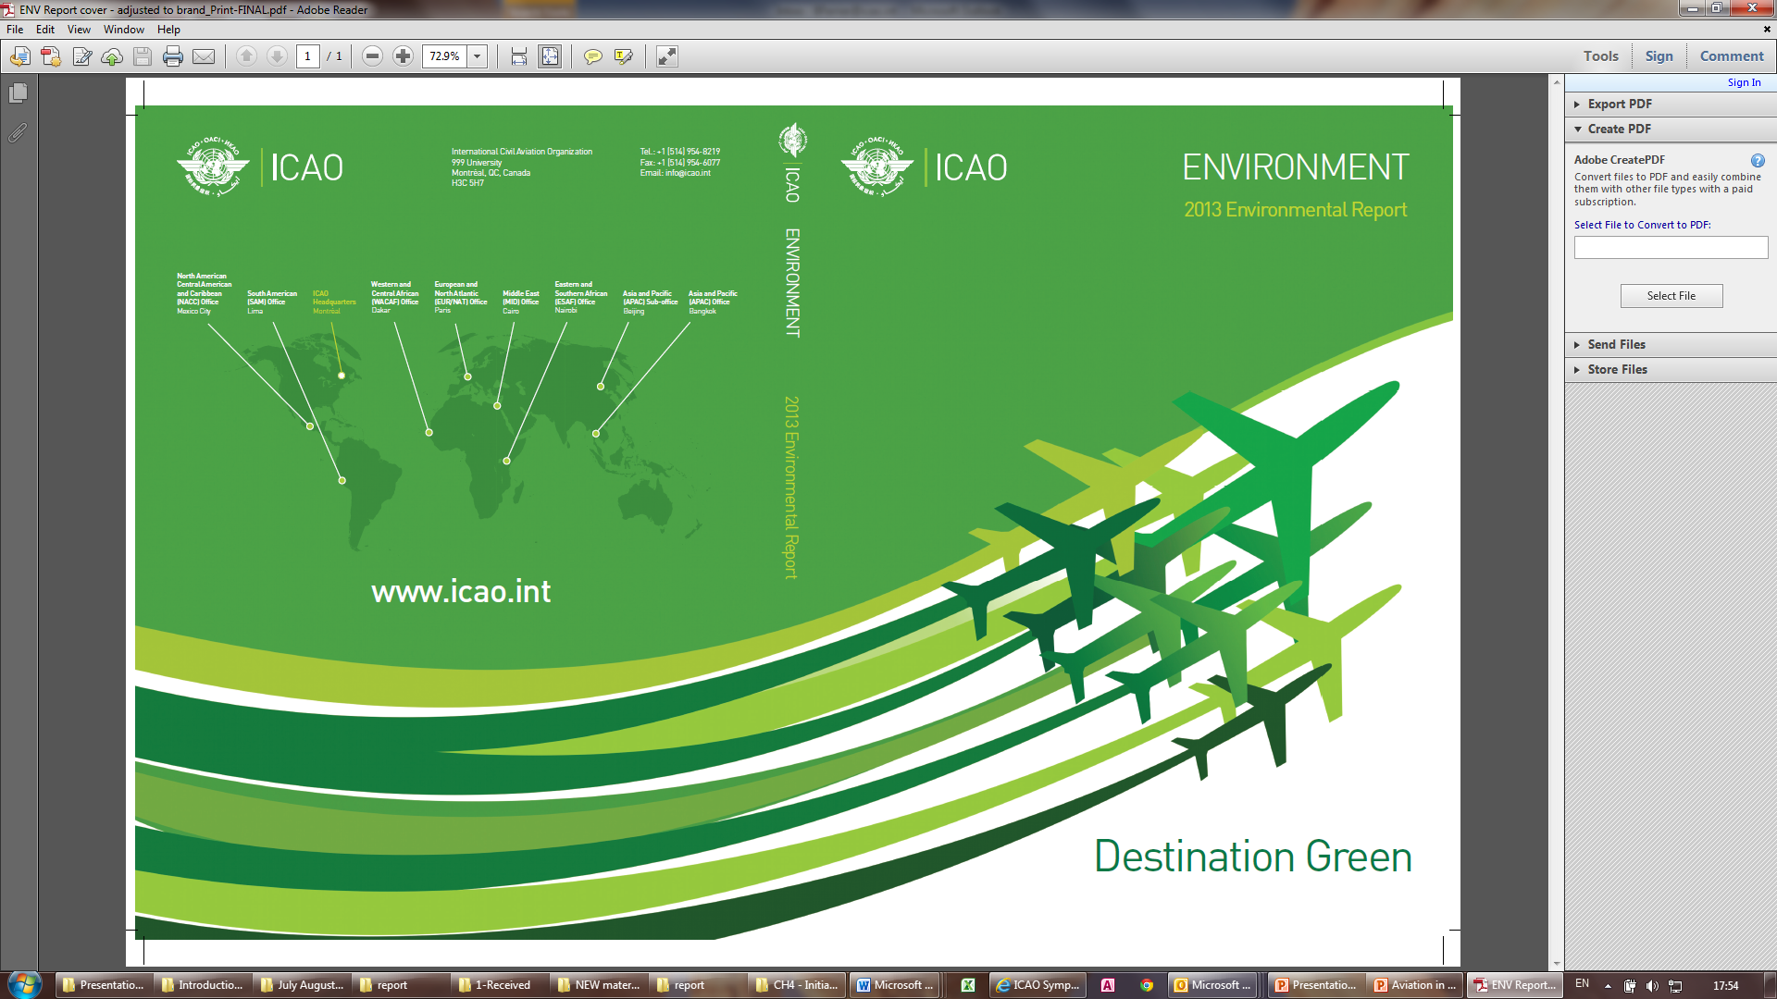
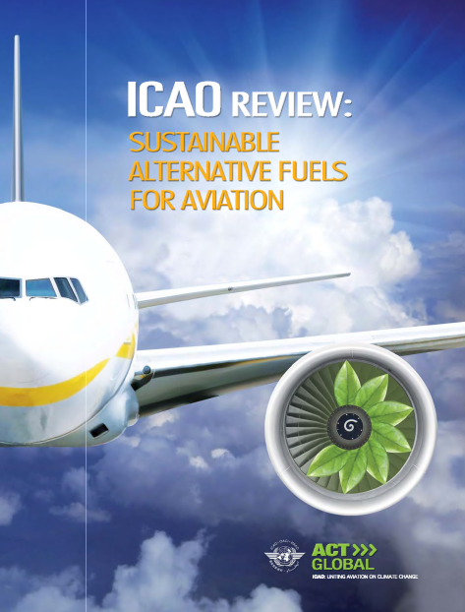

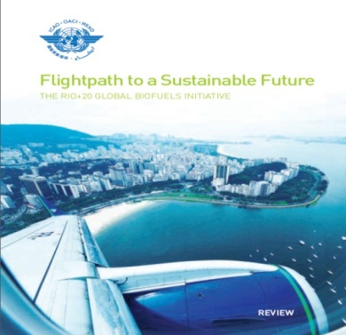
Additional information
For more information on our activities, please visit ICAO’ website: http://www.icao.int/env
Notes:
For more background information on ICAO’s activities, please visit ICAO’s website: http://www.icao.int/env.
In order to learn more about ICAO’s work in the environmental field I would also recommend you read the following publications, all accessible from our website:
the ICAO Journal special environmental editions,
the ICAO Sustainable alternative fuels workshop Review, and
the last ICAO environmental report on aviation and climate change.

Slide 18
CAAFI 2014
General Meeting
& Expo
Joachim Buse,
Vice Chairman, Av. Init. for Renewable Energy in Germany e.V., aireg
Produced by

Slide 19
aireg
Aviation Initiative for Renewable Energy in Germany j
The future of climate-friendly aviation:
Ten percent alternative aviation fuels by 2025
Joachim Buse
Deputy Chairman
Washington D.C.
Jan. 29th, 2014
Notes:
Aireg Deckblatt 01

Slide 20
Global Aviation Market Forecast 2013
Source: Airbus
Notes:
Aireg Standardseite 03

Slide 21
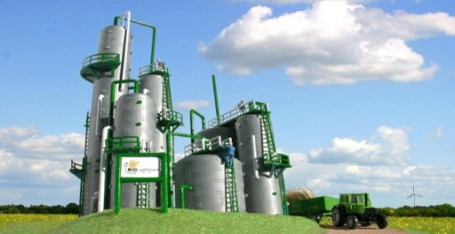


Goals have been defined
  „The future of climate-friendly aviation:
  Ten percent alternative aviation fuels by 2025“
  Top-3-goals for 2025, to achieve CO₂-reduction targets set by policymakers and the aviation industry:
  Domestic biorefining capacity with at least one industrial-scale facility
  Bilateral government agreements to safeguard provision of foreign feedstock
  Blending of 10% alternative aviation fuel in Germany
Notes:
Die EU fordert in ihrem Weißbuch Verkehr von 2011 eine Nutzung von 40% alternativem Flugkraftstoff bis 2050, bis 2020 will die EU eine Produktionskapazität von 2 Mio. Tonnen Biokerosin erreichen. Hieran orientiert sich aireg mit dem 10% Ziel bis 2025. Bei einem zu erwartenden Verbrauch von 11 Mio. Tonnen Kerosin in 2025 entspricht der 10% ca. 1 Mio. Tonnen Biokerosin.
Die weltweite Herstellungskapazität von HEFA-Biokerosin (Neste Oil) beträgt 2 Mio. Tonnen. Die Errichtung von geeigneten Bioraffinerien in Deutschland bietet großes volkswirtschaftliches Potential. Die internationale Dynamik wird zu einer großen Nachfrage nach entsprechendem ingenierwissenschaftlichen Know-how führen.
Im Bioenergiesektor ist viel Lehrgeld gezahlt worden. Politik und Industrie wissen heute, welche Kriterien im Bereich Nachhaltigkeit, soziale Verantwortung und Entwicklungspolitik einzuhalten sind. Regierungsvereinbarungen zwischen Deutschland und potentiellen Lieferstaaten können die Einhaltung dieser Standards garantieren und Transparenz schaffen.

Slide 22

































33 members

Slide 23





Working groups
Provision of Feedstock
Technologies of Fuel Production
Fuel Utilisation
Quality and Certification
Sustainability
5 Working Groups cover the core areas from crop to tank
Notes:
Die inhaltliche Arbeit von aireg geschieht in unseren Arbeitskreisen. Jedes Mitglied entsendet Fachleute in mindestens einen AK. Diese Expertise macht aireg zum Kompetenzzentrum für alternative Flugkraftstoffe in Deutschland und darüber hinaus.

Slide 24
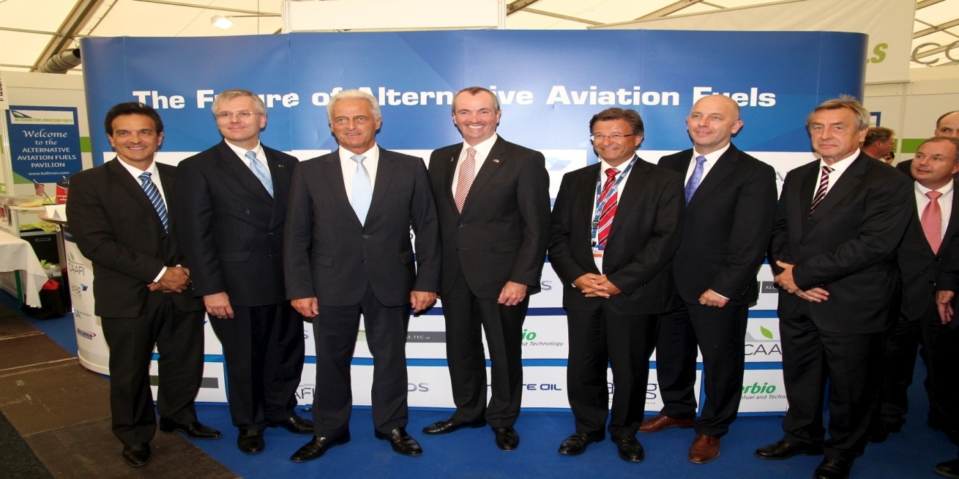
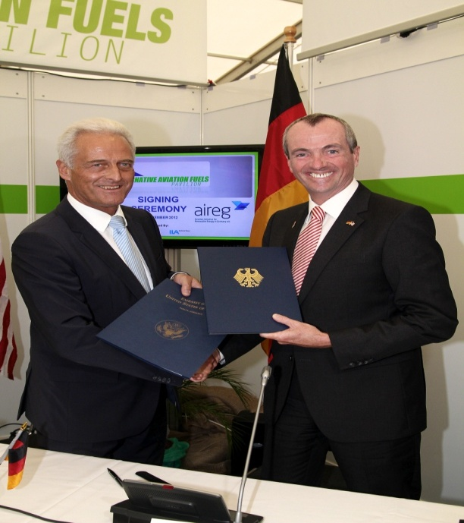
First agreements have been signed
  USA and Germany signed a government agreement to support and use alternative aviation fuel during ILA Berlin Air Show 2012
  Goals: Strengthening of cooperation for the development of sustainability standards, the qualification of new production pathways and the expansion of the feedstock base for alternative aviation fuel
Notes:
Aireg Standardseite 03

Slide 25
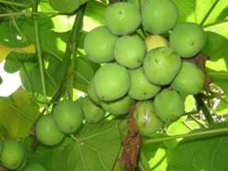
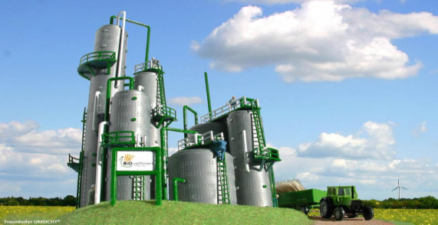

Federal Mobility and Fuels Strategy
  The Mobility and Fuels Strategy of the Federal German Government calls for a „National Development Plan Alternative Aviation Fuels“
  aireg suggests following items for the Development Plan to follow:
  1. Provision of Feedstocks:
  Pilot projects and risk minimization
  2. Biorefineries:
  Location scouting and investment support
  3. Market Readiness:
  Reduction of margins and upscaling
Notes:
Vorbild CAAFI: neue, komplexere Wertschöpfungskette erfordert intensiven Austausch und Kooperation aller Beteiligter
internationale Ziele zur CO2-Minderung im Luftverkehr erfordern nationale Umsetzungsschritte – hierfür will aireg als Katalysator dienen

Slide 26

Provision of Feedstocks – goal: risk minimization
            Status quo:
            Financing of biomass projects is too often hampered by investment risks
            Security of supply as a policy goals is underrated
            Suggested abatement / mitigation measure:
            Lowering of investment risks (country and climate risk) through publically financed and scientifically conducted pilot projects
            Realization:
            e.g. extension of the scope of the German Raw Materials Agency (DERA) to include biomass as a strategic resource
            Goal: bioenergy task force to identify, organize and finance feedstock trials
            Deliverables:
            Selection of biomass project with predictable success rate
            Bilateral gov‘t agreements on production and export criteria
            Clarification of market potential of by-products
            Costs: ca. 30 Mio. € over a 10-year timeframe
Notes:
Forschungsinstitute, Fluggesellschaften und Luftfahrtindustie bündeln ihre Kräfte um möglichst schnell bestehende offene Fragen für die Markteinführung alternativer Flugkraftstoffe zu klären.
Europaweit einzigartige Struktur zieht zunehmend auch ausländische Mitglieder an

Slide 27







Provision of Feedstocks –
structure of DERA bioenergy task force
DERA‘s mission statement:
„The German Raw Materials Agency (DERA) is the center of competence for the feedstock industry and the central platform for information and consulting on mineral and energy resources for the German Economy.“
Comparison of aireg goals and DERA‘s mission
aireg goal | DERA‘s mission | Compatibility
Financing of biomass trials | exploration support program
Investment guarantees for biomass projects | Investment guarantees for exploration
Possible structure and competencies of DERA bioenergy task force
Financial Support Country Expertise Co-Financing Consulting Demand
Notes:
Forschungsinstitute, Fluggesellschaften und Luftfahrtindustie bündeln ihre Kräfte um möglichst schnell bestehende offene Fragen für die Markteinführung alternativer Flugkraftstoffe zu klären.
Europaweit einzigartige Struktur zieht zunehmend auch ausländische Mitglieder an

Slide 28
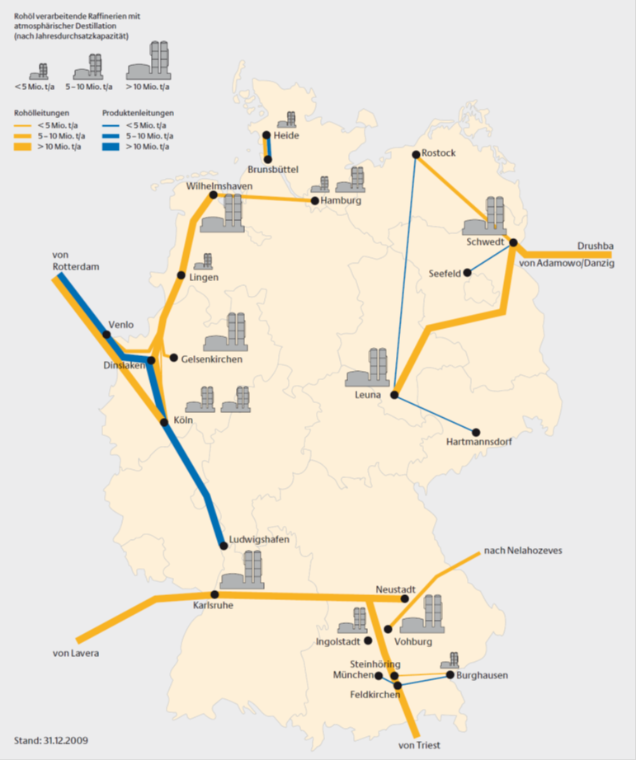

Biorefineries – Concepts for Germany
„Research, development, testing and use of regenerative fuels should be accelerated for aviation. (German Energy Agency (dena), 2011)
            IMPORTANT:
            Study on German biorefining options
            Analysis of all German refineries regarding suitability for upgrading or extension into biorefineries (HEFA, BioGtL, Co-Processing)
            Evaluation of economic benefit of domestic biorefineries, incl. export opportunities for plant manufacturers and reduction of dependancy on product imports
            Suggestions for operator modells and marketing of by-products
            Costs: ca. 500.000 €
Notes:
Forschungsinstitute, Fluggesellschaften und Luftfahrtindustie bündeln ihre Kräfte um möglichst schnell bestehende offene Fragen für die Markteinführung alternativer Flugkraftstoffe zu klären.
Europaweit einzigartige Struktur zieht zunehmend auch ausländische Mitglieder an

Slide 29

Biorefineries - Financing
            KfW investment programm „biorefineries“
            On the basis of the aforementioned study, the construction of a biorefinery of industrial scale shall begin until 2015
            An investment facility „biorefineries“ by the public banking group KfW is to give grants of 30% of the investment costs (€ 0.6 to 1 billion for each plant)
            Benefit:
              Construction of next-generation biorefineries
              Synthetic fuel for several modes of transport without blending walls
              Support for the „Energiewende“ in the transport sector
              Competitive advantage für export-oriented plant manufacturers
              Cost share: ca. € 600 Mio. for 2 plants
              Example: Environmental Innovation Program
              (German Ministry of the Environment)
Notes:
Forschungsinstitute, Fluggesellschaften und Luftfahrtindustie bündeln ihre Kräfte um möglichst schnell bestehende offene Fragen für die Markteinführung alternativer Flugkraftstoffe zu klären.
Europaweit einzigartige Struktur zieht zunehmend auch ausländische Mitglieder an

Slide 30
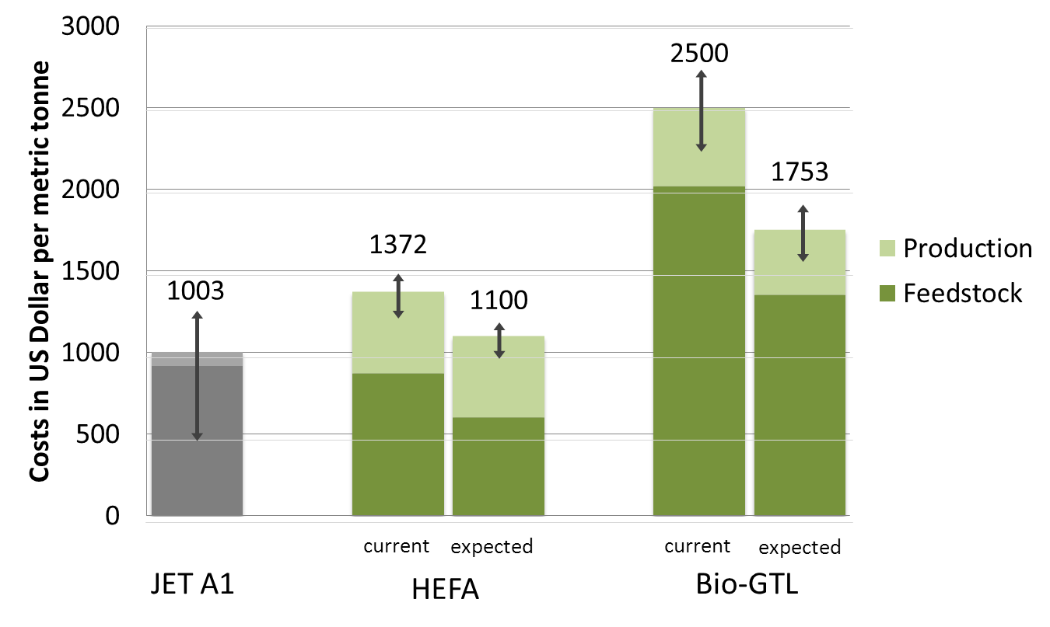
Market readiness – enhancing compatitiveness
            Current price differences prohibit an increased usage of alternative aviation fuel
            The aforementioned measures contribute to lowering the high price of alternative aviation fuel
            The most important lever is the price of feedstock
            The increase of biomethane production lowers costs towards the price range of natural gas
            The up-scaling of FT-production lowers unit costs
2
3
Long-term supply agreements lower and fix the plant oil price
1
*
2
            Legend
            The increasing demand, especially for middle distillates (diesel, jet fuel) is probable cause for a further price increase of fossil fuel. Therefore price parity is just a matter of time.
            The arrow sign shows the price range of Jet A1 in the last five years. The costs of biogenic jet fuel on the basis of HEFA and Bio-GtL is given a bandwith of +/- 10% on the basis of aireg‘s cost calculations.
1
3
Notes:
Forschungsinstitute, Fluggesellschaften und Luftfahrtindustie bündeln ihre Kräfte um möglichst schnell bestehende offene Fragen für die Markteinführung alternativer Flugkraftstoffe zu klären.
Europaweit einzigartige Struktur zieht zunehmend auch ausländische Mitglieder an

Slide 31

Contact:
aireg e.V.
Georgenstr. 25
10117 Berlin
Germany
kontakt@aireg.de
www.aireg.de
Thank you!
Hope to see you again at Berlin!
May 20-25, 2014

Slide 32
CAAFI 2014
General Meeting
& Expo
Susan Pond,
Chair, Australian Initiative for Sustainable Aviation Fuels, AISAF
Produced by

Slide 33

Dr. Susan M Pond
AISAF Chair
CAAFI International Panel
29 Jan 2014

Slide 34

Founded in August 2012 within The United States Studies Centre at the University of Sydney by consortium of leaders in the public and private sectors
Strategic direction-setting group aiming to
  facilitate the development and growth of SAF industry in Australia
  create a platform of robust collaborations throughout the entire SAF value chain, including civil and military aviation
  work collaboratively with international partners, including CAAFI under the US Australia MOU signed in Sep 2011
Joined forces with Aviation Aerospace Australia August 2013

Slide 35


AISAF Structure & Governance
Steering Committee Chair & Members
Working Groups
1. Feedstocks & Processing Technologies
2. Certification
3. Environmental Impacts
4. Commercialisation
Collaborate on R&D gaps
Support novel fuel R&D
Share technology info
Identify feedstock issues
Coordinate data/activities
Advocate new certifications
Support commercial flights
Coordinate analysis
Address research gaps
Advocate standards
Share commercial analyses
Share methodologies
Share supply chain best practice
Industry & Government Stakeholders

Slide 36

AISAF Steering Committee
W: aisaf.org.au
E: aisaf-chair@aviationaerospace.org.au

Slide 37
SAF Industry Opportunity for Australia
Criteria | Score
Market Need/Leading Edge Customers | ✓✓✓
In Australia’s national Interest – security, economy | ✓✓
Competitive capacity/capability to build on | ✓✓
Comparative advantage to exploit | ✓✓✓
Not too late to enter field | ✓✓✓
Evident overseas market opportunity | ✓✓✓
atse.org.au/Documents/Publications/Reports/Energy/Green%20Growth%20Energy%20
Report/ATSE%20Green%20Growth%20Report.pdf

Slide 38
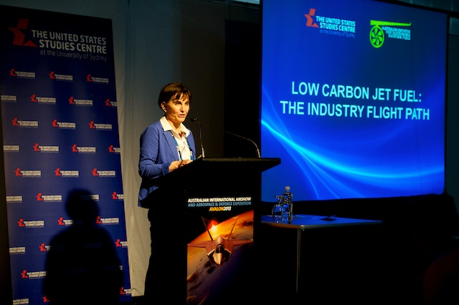
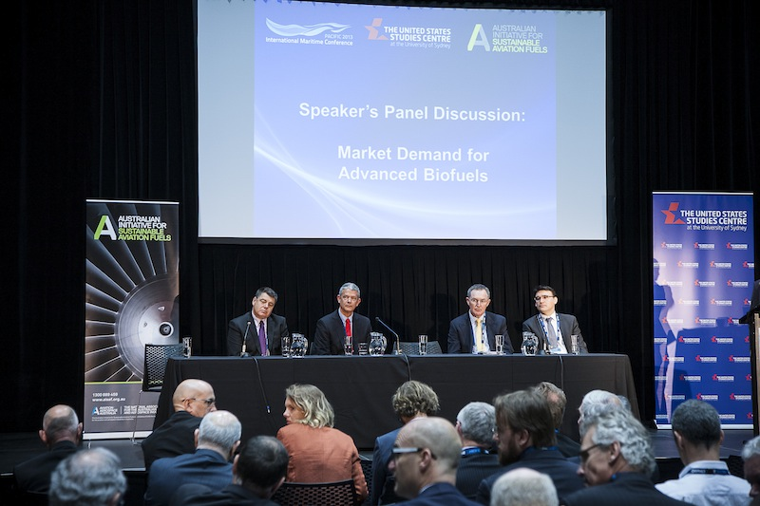
Australian Market Leading Demand
2012 fuel costs: Qantas, $4B; Virgin, $1B
ADF, premium, boutique, low volume fuels
Government engagement
http://www.aisaf.org.au/events/low-carbon-jet-fuel-the-industry-flight-path
http://www.aisaf.org.au/events/advanced-biofuels-industry-day

Slide 39
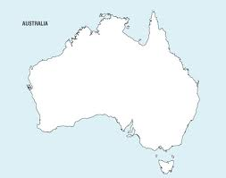
Current Production of SAF

Slide 40
A long-term future for aviation powered by sustainable fuels
W: aisaf.org.au
E: aisaf-chair@aviationaerospace.org.au

Slide 41
CAAFI 2014
General Meeting
& Expo
Alexandre Filizola, Environment Technical Manager, ANAC
Mike Lu, Coordinator, Brazilian Biojetfuel Platform
Produced by

Slide 42

Brazilian Efforts for Aviation Alternative Fuels Development ANAC Initiative
Jan. 28 – 29th, 2014
2014 CAAFI General Meeting
Washington, D.C

Slide 43
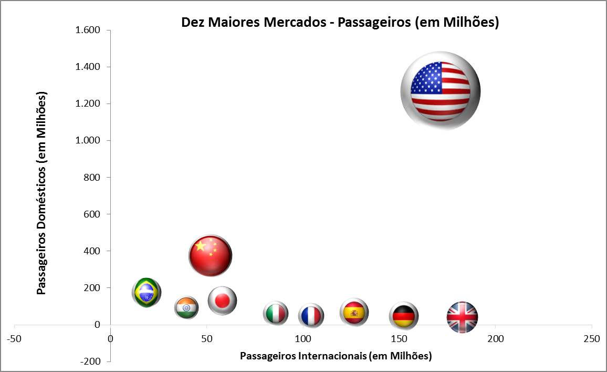

Brazilian civil aviation in context
Source: World Airport Traffic Report, 2012 . ACI Airports Council International
Notes:
US 25%
Brazil 3%

Slide 44
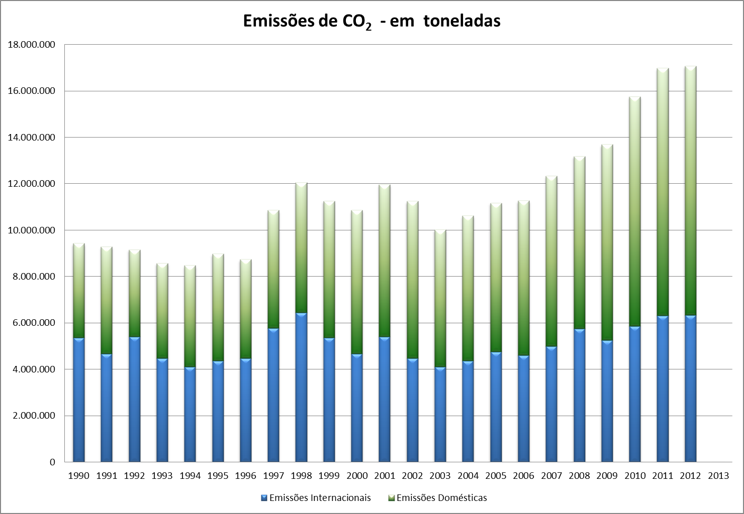
Emissions evolution: jet A fuel
Source: ANAC Emissions Mapping System - MIATA
Notes:
Total para 2012 17.082.124 (37 % internacional, 63 % doméstico)

Slide 45
Government initiatives
Regulatory Framework
ANP
Resolution 20
June 2013
Approves the usage of alternative fuels in country; (ASTM 7566).
Brazilian Action Plan
Presented to ICAO during the 38th Assembly;
Brazil presented a reservation to the item in the resolution that propose the 2020 carbon neutral growth.

Slide 46
Anac initiative
ALTERNATIVE JET FUEL SUSTAINABILITY ANALYSIS LCA FOR SUGARCANE FEEDSTOCK
ASSESSMENT OF CNG NEEDS FOR BRAZILIAN AVIATION
Objective: Foster the development and adoption of locally produced biofuel, based on existing feedstock sugarcane by providing precise information regarding the environment benefits of this particular type of renewable biofuel.
Objective: Provide support for government and industry actions/decisions based on a common goal for renewable bio-jet fuel production within the country.

Slide 47
Thank you !
Alexandre Filizola
Manager of Environmental Analysis
Superintendence of International Relations
Email: alexandre.filizola@anac.gov.br
+ 55 61 3314-4620
www.anac.gov.br

Slide 48

“Brazilian Biojetfuel Platform”
Jan. 28 – 29th, 2014
2014 CAAFI General Meeting Washington, D.C.

Slide 49




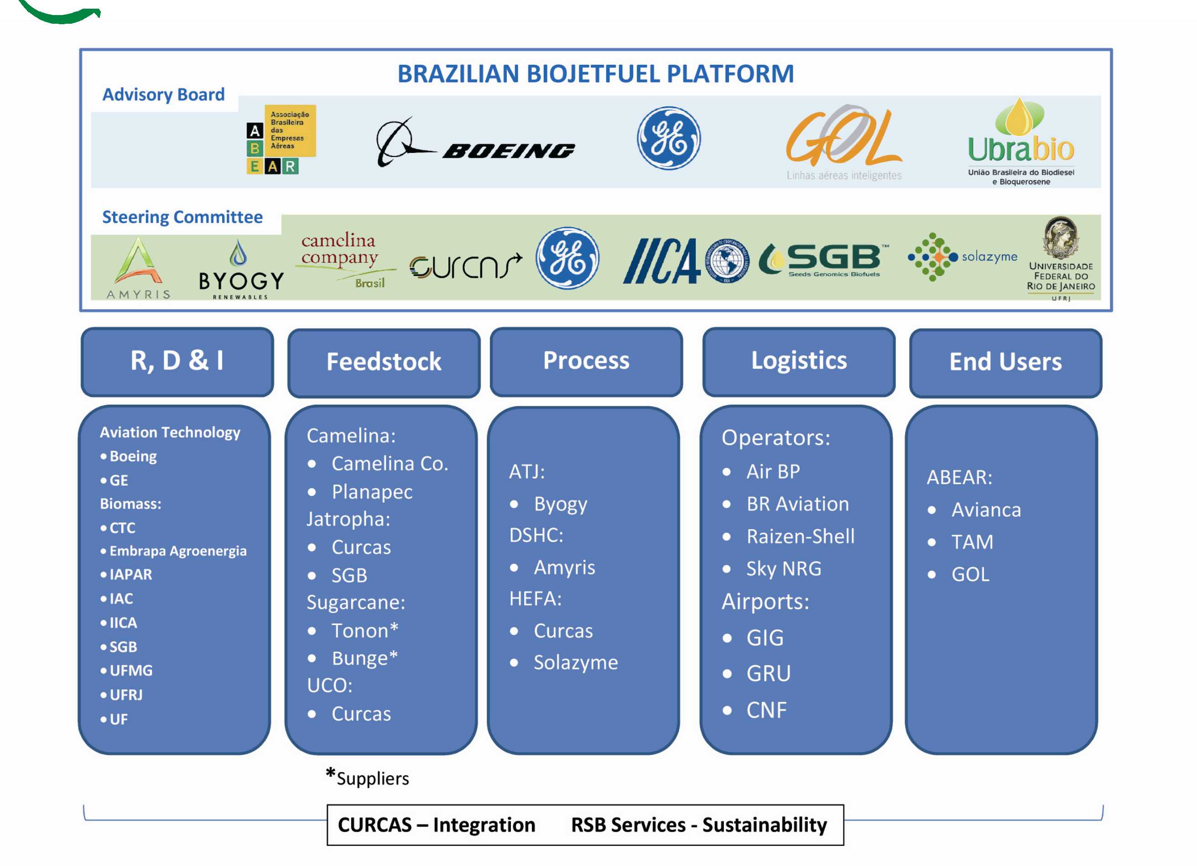
Brazilian Biojetfuel Platform
Taking off with Sustainability

Slide 50





Brazilian Biojetfuel Platform
Formally structured in August 2013 to implement a feedstock agnostic , multi-process platform:
HEFA, DSHC, ATJ.
Focus on integrated value chain and sustainable feedstock production based on the Brazilian biodiversity, climatic conditions, Family Farming, and Agribusiness.
Consolidates
the stakeholders of the full
spectrum of the value chain: optimization.
Committed to the efforts of the Brazilian Action Plan submitted to ICAO.

Slide 51





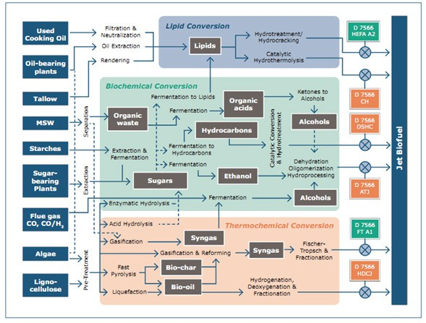
SABB - Biojetfuel gap analysis
Fonte: SABB

Slide 52





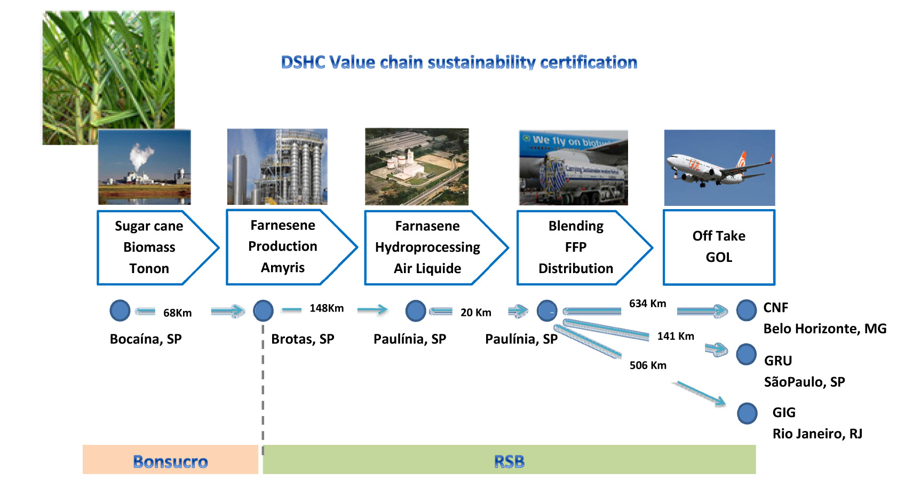
Sustainable DSHC value chain

Slide 53




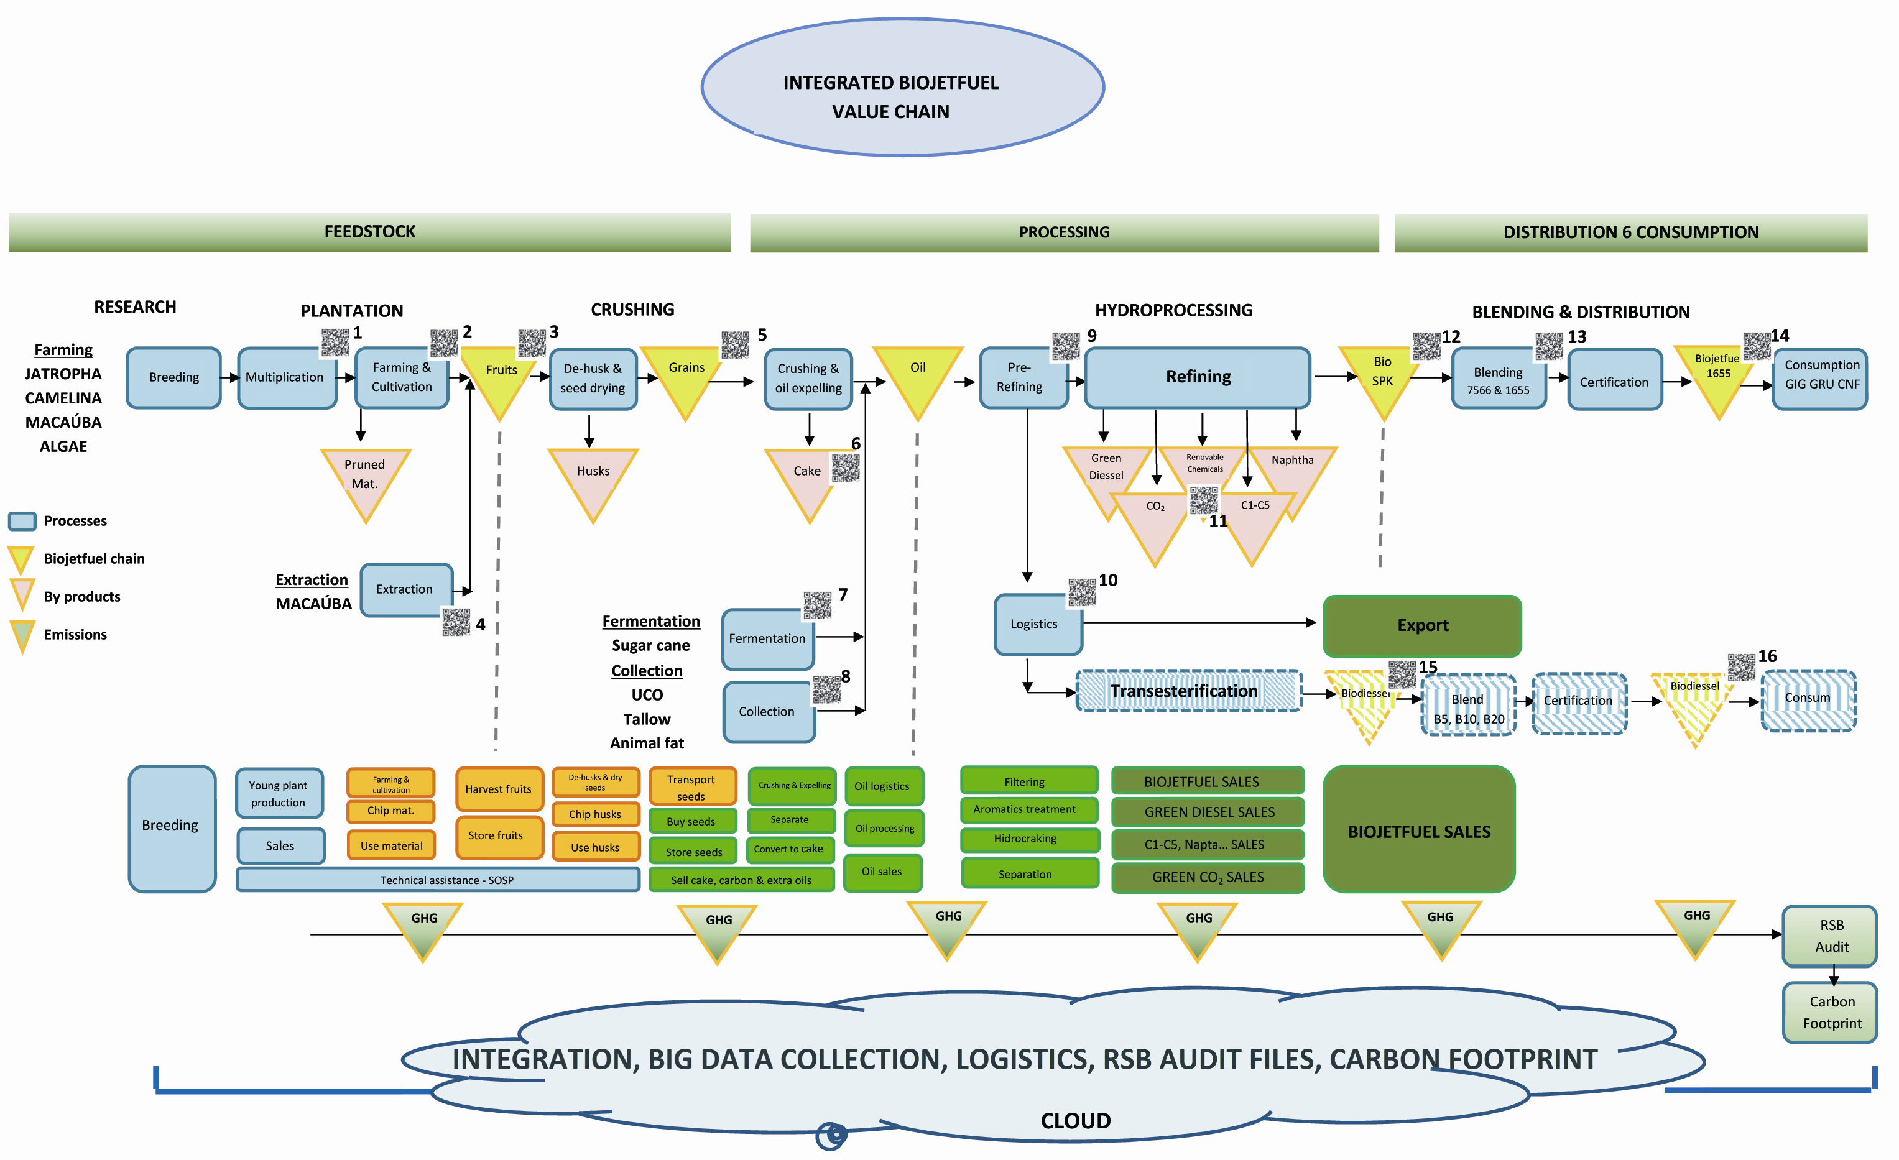
Biojetfuel HEFA value chain

Slide 54





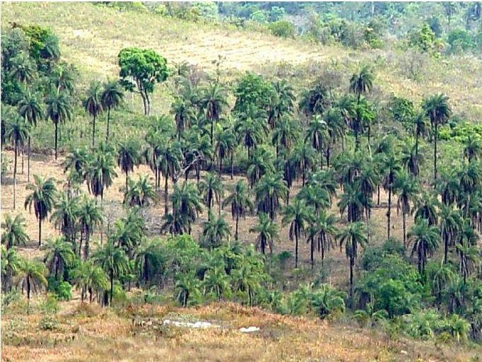
Brazilian Biodiversity: Macaúba value chain

Slide 55




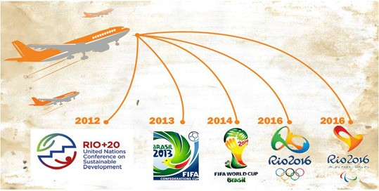
Flying Green Program
Carbon Footprint Offset

Slide 56




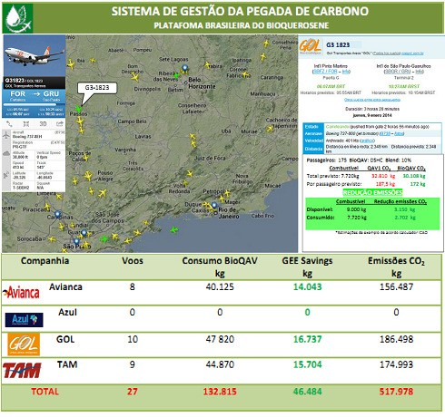
Flying Green Carbon Footprint

Slide 57




Brazilian Biojetfuel Platform
Taking off with Sustainability
Thanks !
Mike Lu
Coordinator Brazilian Biojetfuel Platform
mike.lu.44@gmail.com
+55 11 98438 3743

Slide 58
CAAFI 2014
General Meeting
& Expo
César Velarde Catolfi-Salvoni, SENASA, OBSA Manager, Bioquereseno
Produced by

Slide 59








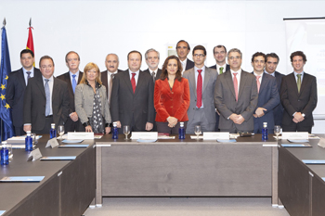
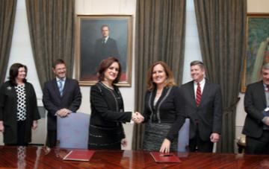





















2011
2012 US – SPAIN
Declaration of Cooperation
on Aviation Alt. Fuels
Supported by
Management
FEEDSTOCK
TECHNOLOGY
LOGISTICS/USE
SUSTAINABILITY

Slide 60



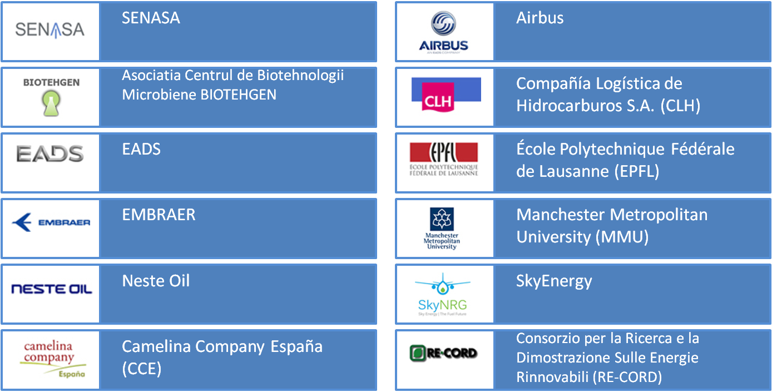
Roadmap
2010 – 2011
2011 – 2013
2014 – onwards
FEASIBILITY STUDY
DEMONSTRATION
PHASE
IMPLEMENTATION
PHASE
12 partners
from 9 States
www.itaka-project.eu

Slide 61



Roadmap
2010 – 2011
2011 – 2013
2014 – onwards
FEASIBILITY STUDY
DEMONSTRATION
PHASE
IMPLEMENTATION
PHASE
European coordination and support actions
FORUM-AE
www.core-jetfuel.eu
ICAO CAEP
Alternative Fuels Task Force (ATFT)

Slide 62




SUSTAINABLE AVIATION FUELS WEEK
MADRID,
21-24 October 2014
www.bioqueroseno.es
CÉSAR VELARDE
Manager, Observatory of Sustainability in Aviation (OBSA)
cvelarde@senasa.es
www.itaka-project.eu
Avenida de la Hispanidad, nº 12
28042 Madrid, Spain
www.core-jetfuel.eu
FORUM-AE

